Slide 1
MET CS 555 – Foundations of Machine Learning Lecture 10: ANOVA and Regression, ANCOVA
Hongsheng Wu
Boston University

Slide 2
Study Guide
ANOVA and Regression
One-way Analysis of Covariance (ANCOVA)
Two-way Analysis of Variance

Slide 3
ANOVA and Regression

Slide 4
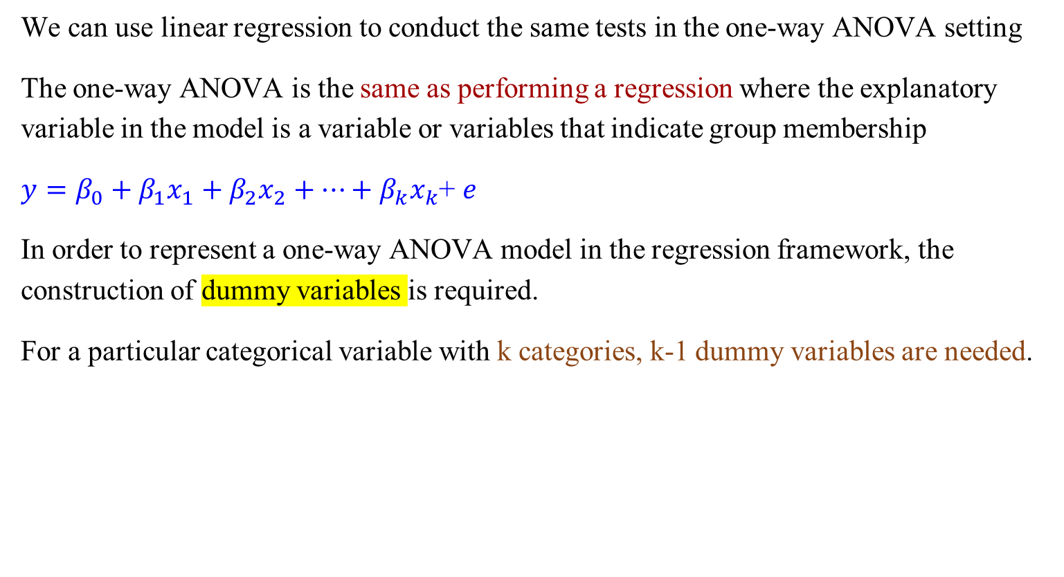
One-Way Analysis of Variance and Regression
We can use linear regression to conduct the same tests in the one-way ANOVA setting
The one-way ANOVA is the same as performing a regression where the explanatory variable in the model is a variable or variables that indicate group membership
$y=β_{0}+β_{1}x_{1}+β_{2}x_{2}+…+β_{k}x_{k}$+ $e$
In order to represent a one-way ANOVA model in the regression framework, the construction of dummy variables is required.
For a particular categorical variable with k categories, k-1 dummy variables are needed.

Slide 5
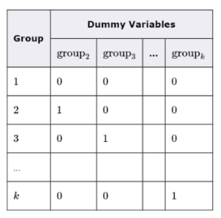
One-Way Analysis of Variance and Regression
For a particular categorical variable with k categories, k-1 dummy variables are needed
Dummy variables are binary variables of the form:
The category omitted (group 1 in this case) is referred to as the reference group
A dummy variable for the reference group is not needed as those in this group can be identified as having values of 0 for all of the defined dummy variables

Slide 6
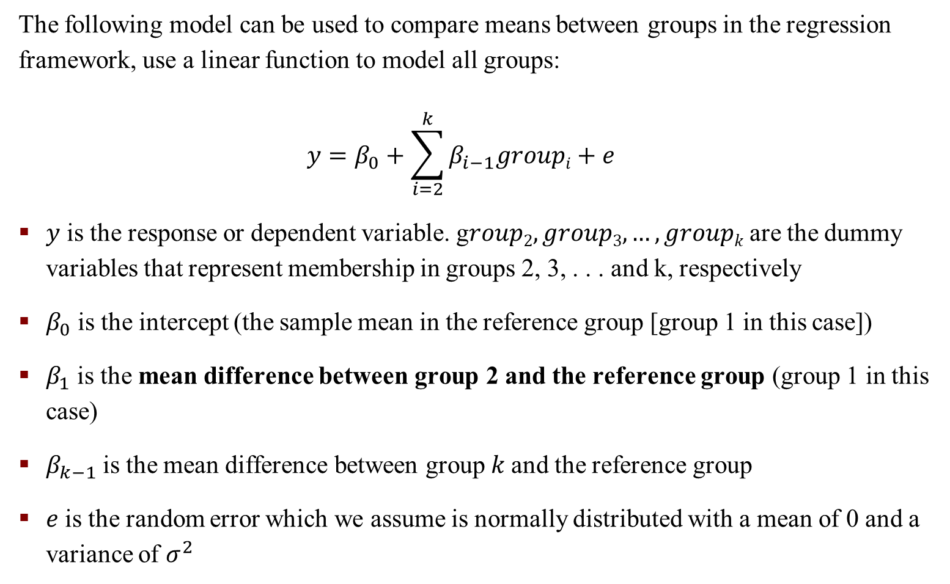
One-Way Analysis of Variance and Regression
The following model can be used to compare means between groups in the regression framework, use a linear function to model all groups:
$$y=β_{0}+\sum_{i=2}^{k}{β_{i−1}groupi}+e$$
$y$ is the response or dependent variable. g$roup2, group3,…, groupk$are the dummy variables that represent membership in groups 2, 3, . . . and k, respectively
$β_{0}$ is the intercept (the sample mean in the reference group [group 1 in this case])
$β_{1}$ is the mean difference between group 2 and the reference group (group 1 in this case)
$β_{k−1}$is the mean difference between group $k$and the reference group
$e$ is the random error which we assume is normally distributed with a mean of 0 and a variance of $σ^{2}$
Notes:
y is not group 1, y can be the response, e.g., distance. Use a unique linear function to model all brands distance

Slide 7
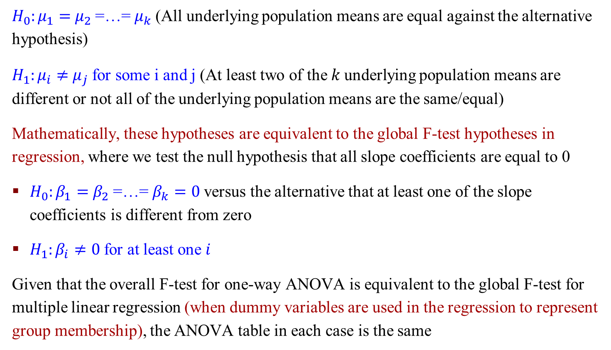
One-Way Analysis of Variance and Regression
$H_{0}:μ_{1}=$ $μ_{2}$=…= $μ_{k}$(All underlying population means are equal against the alternative hypothesis)
$H_{1}:μ_{i}≠$ $μ_{j}$for some i and j (At least two of the$k$underlying population means are different or not all of the underlying population means are the same/equal)
Mathematically, these hypotheses are equivalent to the global F-test hypotheses in regression, where we test the null hypothesis that all slope coefficients are equal to 0
$H_{0}:β_{1}=$ $β_{2}$=…= $β_{k}=0$versus the alternative that at least one of the slope coefficients is different from zero
$H_{1}:β_{i}≠0$for at least one $i$
Given that the overall F-test for one-way ANOVA is equivalent to the global F-test for multiple linear regression (when dummy variables are used in the regression to represent group membership), the ANOVA table in each case is the same

Slide 8
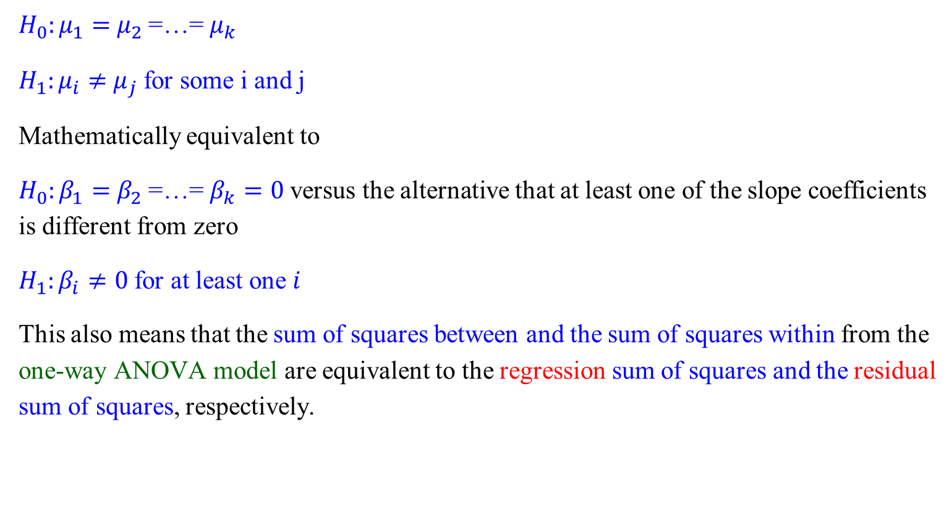
One-Way Analysis of Variance and Regression
$H_{0}:μ_{1}=$ $μ_{2}$=…= $μ_{k}$
$H_{1}:μ_{i}≠$ $μ_{j}$for some i and j
Mathematically equivalent to
$H_{0}:β_{1}=$ $β_{2}$=…= $β_{k}=0$versus the alternative that at least one of the slope coefficients is different from zero
$H_{1}:β_{i}≠0$for at least one $i$
This also means that the sum of squares between and the sum of squares within from the one-way ANOVA model are equivalent to the regression sum of squares and the residual sum of squares, respectively.

Slide 9
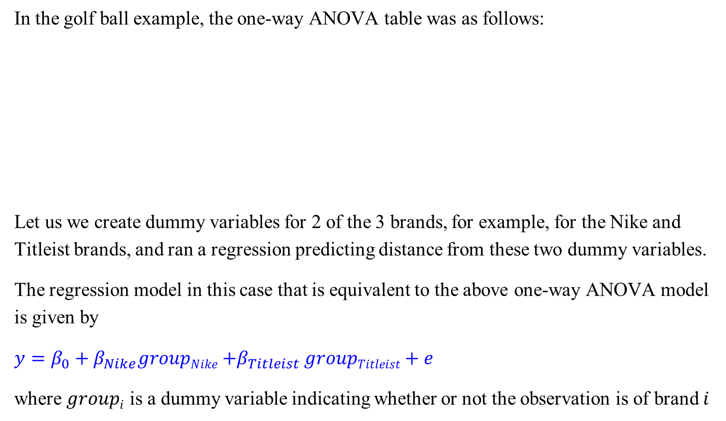
The Golf Ball Example
In the golf ball example, the one-way ANOVA table was as follows:
Let us we create dummy variables for 2 of the 3 brands, for example, for the Nike and Titleist brands, and ran a regression predicting distance from these two dummy variables.
The regression model in this case that is equivalent to the above one-way ANOVA model is given by
$$y=β_{0}+β_{Nike}groupNike{+β}_{Titleist}groupTitleist+e$$
where $groupi$ is a dummy variable indicating whether or not the observation is of brand $i$

Slide 10
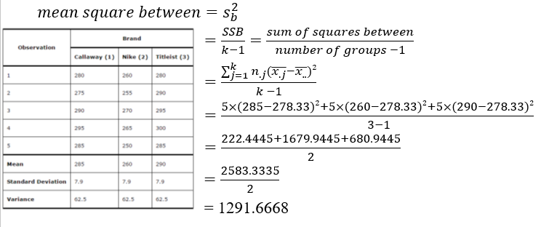
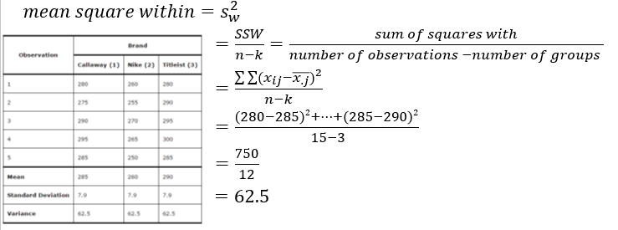
The Golf Ball Example – R Commands

Slide 11
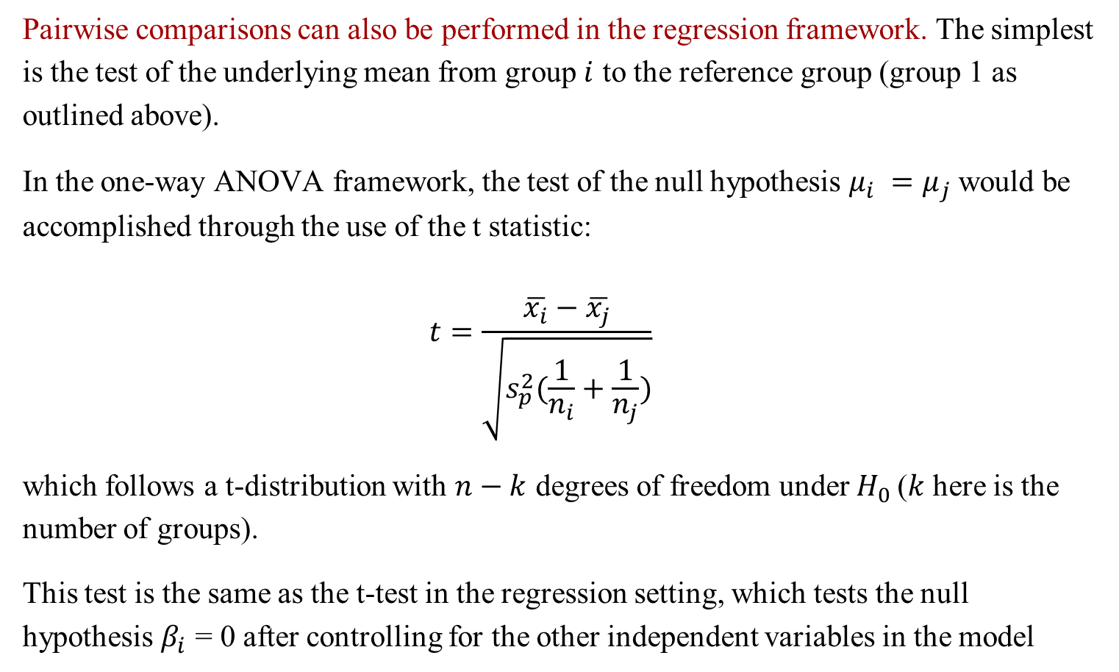
Pairwise Comparisons – t-test
Pairwise comparisons can also be performed in the regression framework. The simplest is the test of the underlying mean from group $i$ to the reference group (group 1 as outlined above).
In the one-way ANOVA framework, the test of the null hypothesis $μ_{i} =μ_{j}$would be accomplished through the use of the t statistic:
$$t=\frac{\overline{x_{i}}−\overline{x_{j}}}{\sqrt{s_{p}^{2}(\frac{1}{n_{i}}+\frac{1}{n_{j}})}}$$
which follows a t-distribution with $n−k$ degrees of freedom under $H_{0}$($k$ here is the number of groups).
This test is the same as the t-test in the regression setting, which tests the null hypothesis $β_{i}$ = 0 after controlling for the other independent variables in the model

Slide 12
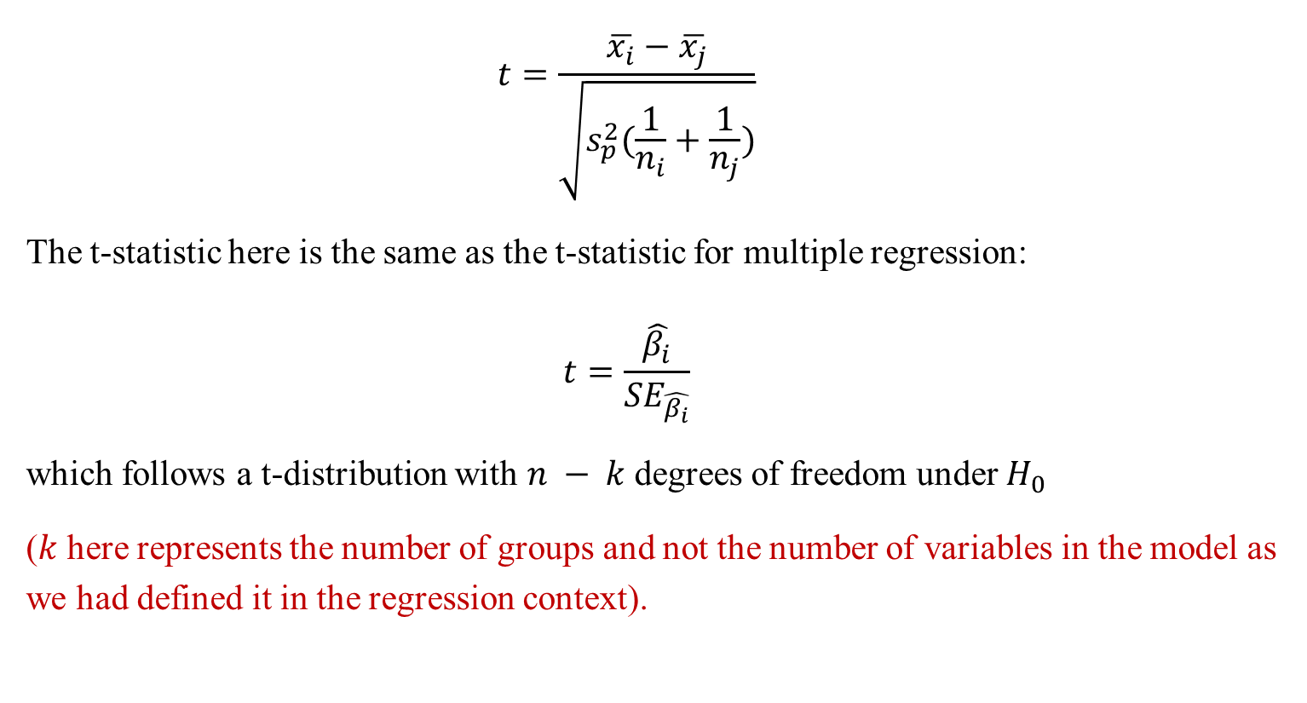
Pairwise Comparisons – t-test
$$t=\frac{\overline{x_{i}}−\overline{x_{j}}}{\sqrt{s_{p}^{2}(\frac{1}{n_{i}}+\frac{1}{n_{j}})}}$$
The t-statistic here is the same as the t-statistic for multiple regression:
$$t=\frac{\hat{β_{i}}}{{SE}_{\hat{β_{i}}}}$$
which follows a t-distribution with $n − k$degrees of freedom under $H_{0}$
($k$ here represents the number of groups and not the number of variables in the model as we had defined it in the regression context).

Slide 13
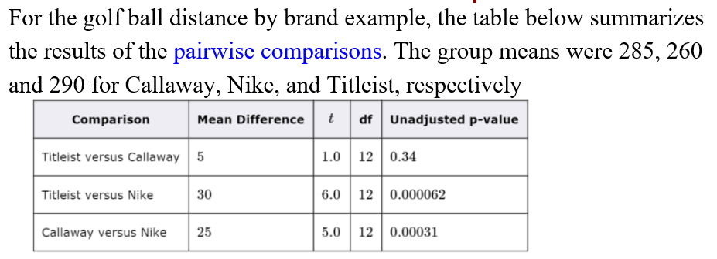
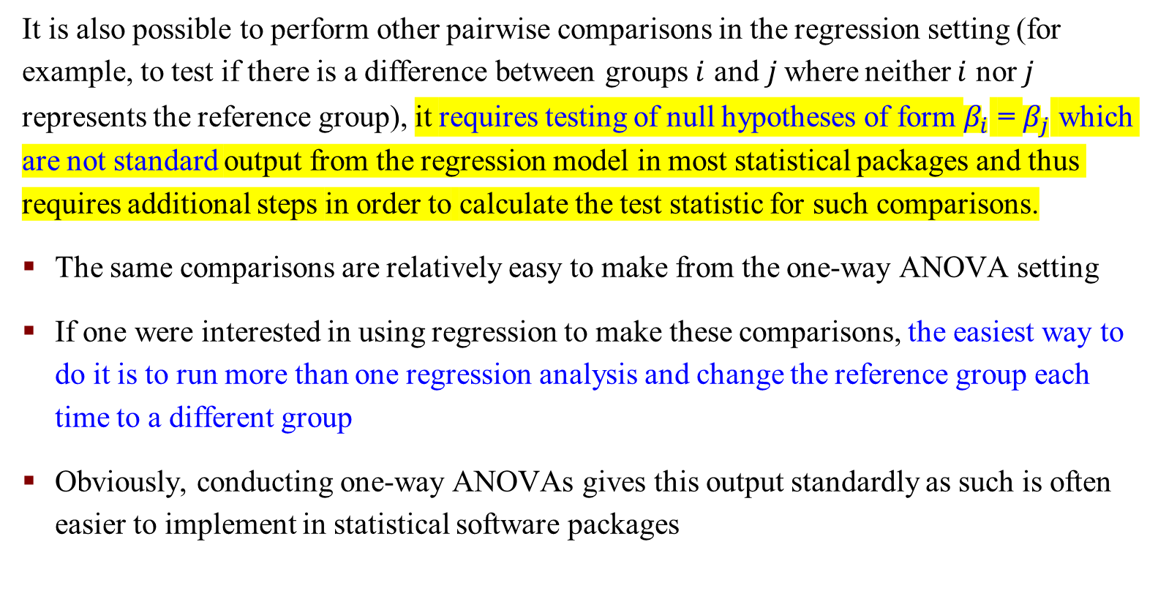
Pairwise Comparisons – t-test
It is also possible to perform other pairwise comparisons in the regression setting (for example, to test if there is a difference between groups $i$ and$j$where neither $i$ nor $j$ represents the reference group), it requires testing of null hypotheses of form $β_{i}$ = $β_{j}$ which are not standard output from the regression model in most statistical packages and thus requires additional steps in order to calculate the test statistic for such comparisons.
The same comparisons are relatively easy to make from the one-way ANOVA setting
If one were interested in using regression to make these comparisons, the easiest way to do it is to run more than one regression analysis and change the reference group each time to a different group
Obviously, conducting one-way ANOVAs gives this output standardly as such is often easier to implement in statistical software packages

Slide 14
One-way Analysis of Covariance (ANCOVA)

Slide 15
One-way Analysis of Covariance (ANCOVA)
Sometimes we have other variables or factors that have an effect on the dependent variables that we are analyzing. But these variables are not actually independent variables.
You want to control the effect of other variables in your analysis.
For example: When you study the effect of different diet types on weight loss, other factors like age or level of training can have an effect. You do not want to consider them as separate independent variables, you just want to check if these variables have an effect on your analysis and control it.
We have multiple variables that have an effect on a single numeric outcome.
This is where we use analysis of covariance.

Slide 16
One-way Analysis of Covariance (ANCOVA)
The other variables are variables that are called “covariates”.
These variables provide additional variations in the subject response value. We want to control these variables.
Covariates are also named “Intervening” or “Confounding Variables”.
ANCOVA is an extension of ANOVA and can be seen as a combination of ANOVA and Regression.
What ANCOVA does is simply takes the effects of covariates out of ANOVA analysis.

Slide 17
One-way Analysis of Covariance (ANCOVA)
ANCOVA is a general linear model that is a combination of ANOVA and regression when you have some categorical factors and some quantitative continuous variables
The continuous variables (on which to perform regression) are called “covariates”
Often, these covariates are not necessarily of primary interest, but still, their inclusion in the model will help explain more of the response and hence reduce the error variance
ANCOVA evaluates whether population means of a response variable are equal across levels of a categorical explanatory variable while statistically controlling for the effects of other continuous variables that are not of primary interest, known as covariates
Mathematically, ANCOVA decomposes the variance in the response variable into variance explained by the covariates, variance explained by the categorical explanatory variables and residual variance

Slide 18
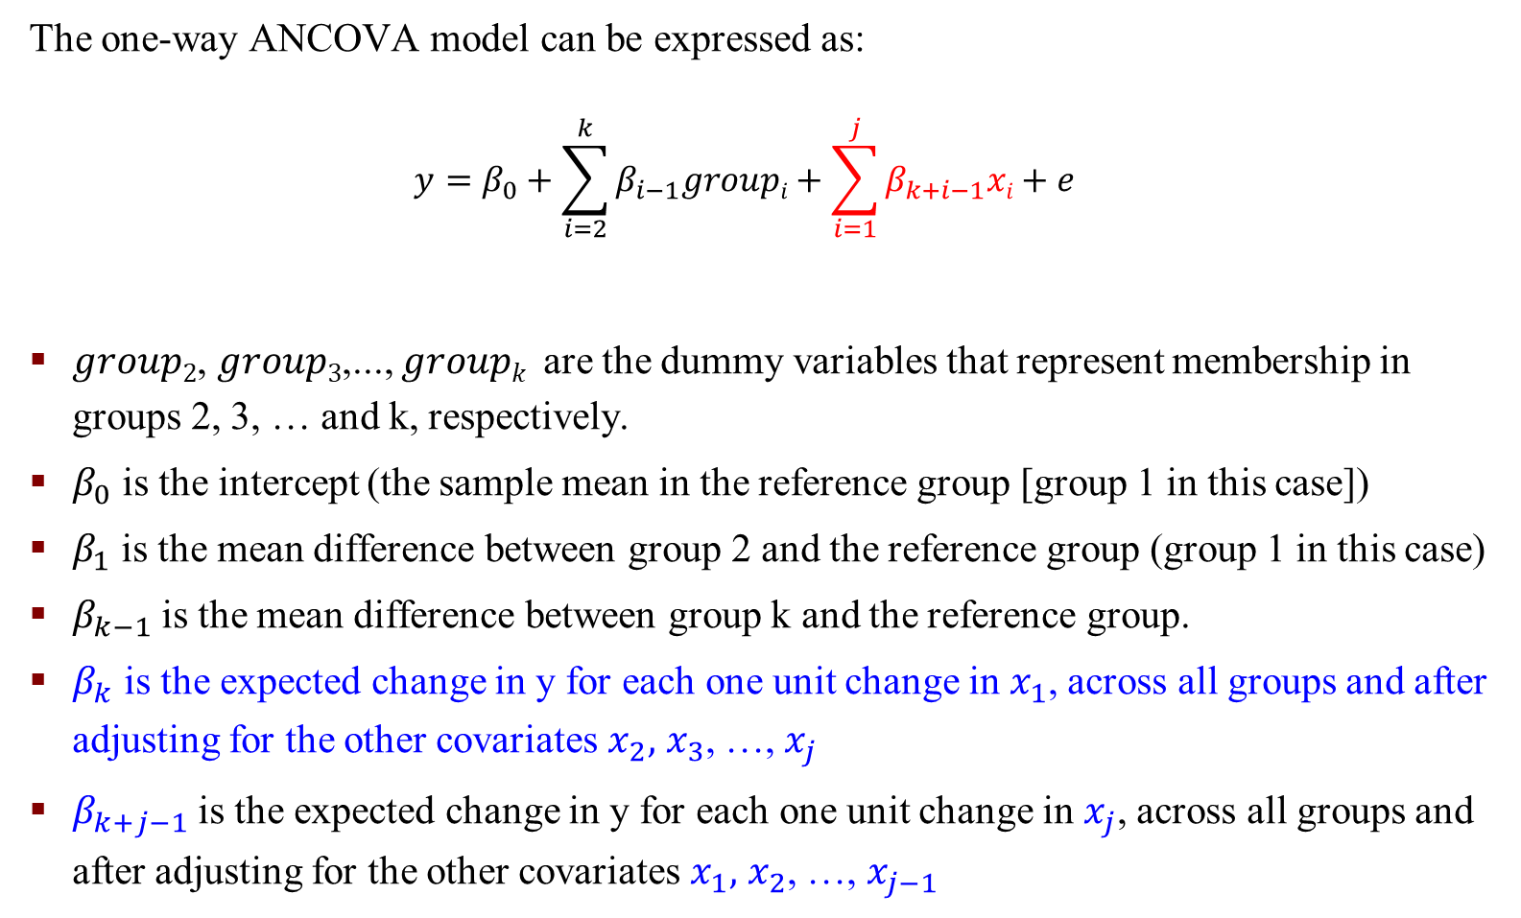
One-way Analysis of Covariance (ANCOVA)
The one-way ANCOVA model can be expressed as:
$$y=β_{0}+\sum_{i=2}^{k}{β_{i−1}groupi}+\sum_{i=1}^{j}{β_{k+i−1}xi}+e$$
$group2$, $group3$,..., $groupk$ are the dummy variables that represent membership in groups 2, 3, … and k, respectively.
$β_{0}$ is the intercept (the sample mean in the reference group [group 1 in this case])
$β_{1}$ is the mean difference between group 2 and the reference group (group 1 in this case)
$β_{k−1}$is the mean difference between group k and the reference group.
$β_{k}$ is the expected change in y for each one unit change in $x_{1}$, across all groups and after adjusting for the other covariates $x_{2},$ $x_{3}$, …, $x_{j}$
$β_{k+j−1}$ is the expected change in y for each one unit change in $x_{j}$, across all groups and after adjusting for the other covariates $x_{1},$ $x_{2}$, …, $x_{j−1}$

Slide 19
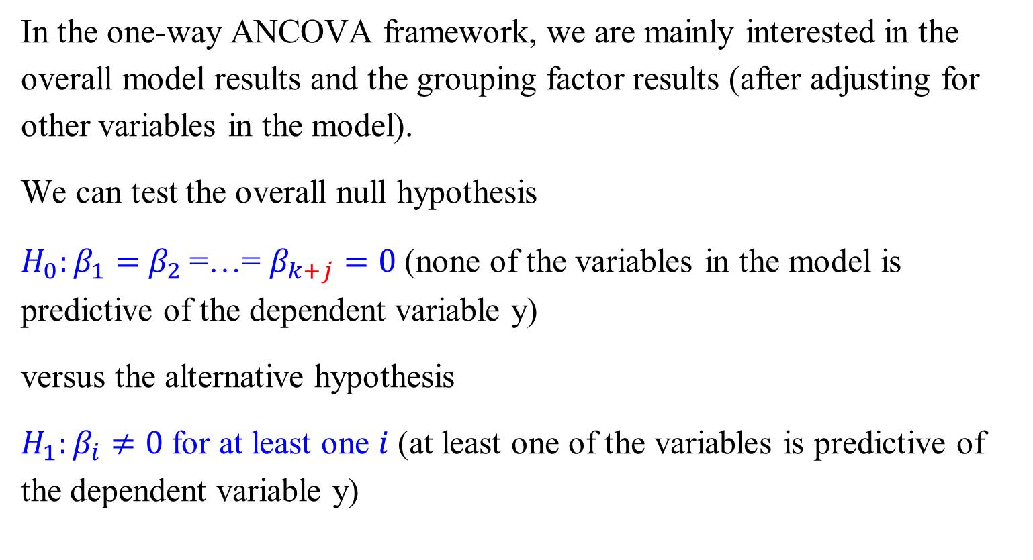
One-Way ANCOVA - Inferencing
In the one-way ANCOVA framework, we are mainly interested in the overall model results and the grouping factor results (after adjusting for other variables in the model).
We can test the overall null hypothesis
$H_{0}:β_{1}=$ $β_{2}$=…= $β_{k+j}=0$(none of the variables in the model is predictive of the dependent variable y)
versus the alternative hypothesis
$H_{1}:β_{i}≠0$for at least one $i$ (at least one of the variables is predictive of the dependent variable y)

Slide 20
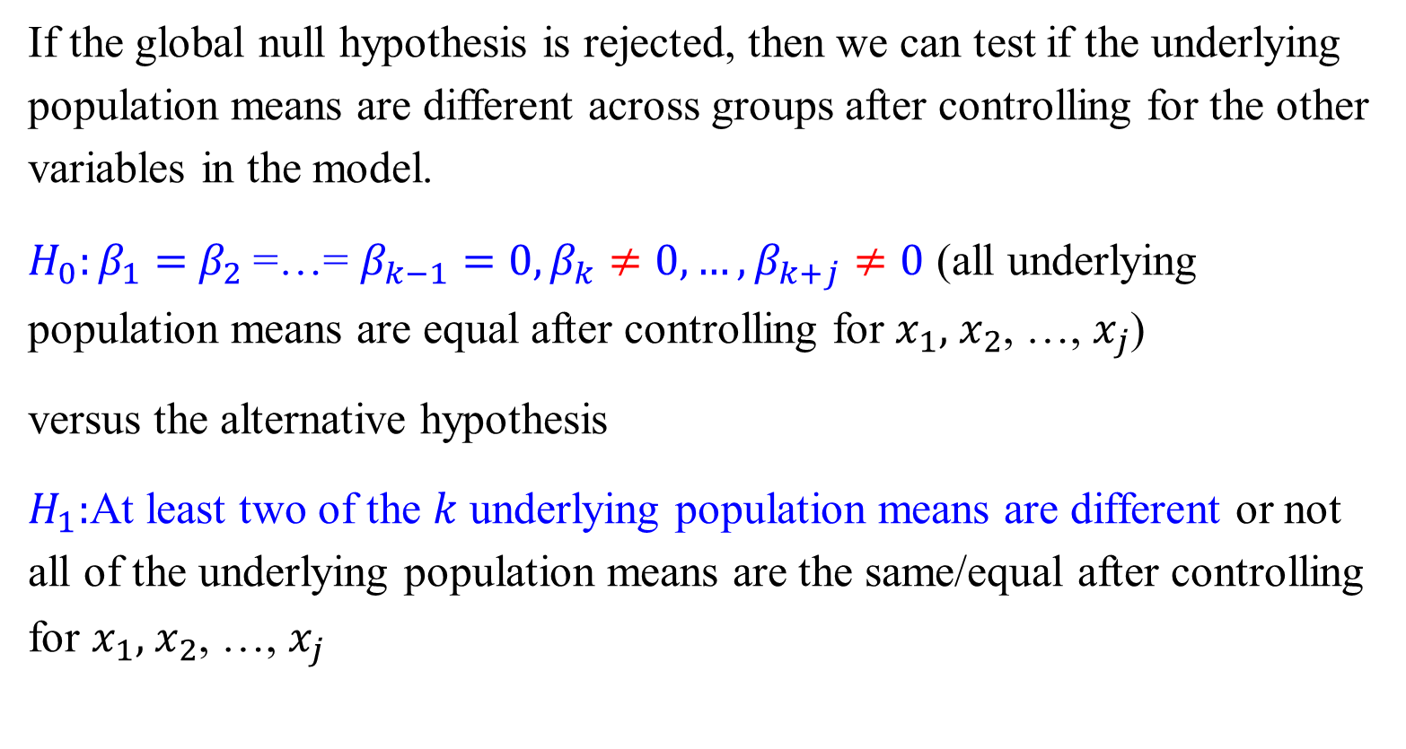
One-Way ANCOVA - Inferencing
If the global null hypothesis is rejected, then we can test if the underlying population means are different across groups after controlling for the other variables in the model.
$H_{0}:β_{1}=$ $β_{2}$=…= $β_{k−1}=0,β_{k}≠0,…,β_{k+j}≠0$ (all underlying population means are equal after controlling for $x_{1},$ $x_{2}$, …, $x_{j}$)
versus the alternative hypothesis
$H_{1}:$At least two of the $k$ underlying population means are different or not all of the underlying population means are the same/equal after controlling for $x_{1},$ $x_{2}$, …, $x_{j}$

Slide 21
One-Way ANCOVA – Least-squares means or LS means
In the ANCOVA setting, if there is a difference between groups after adjusting for the other covariates in the model, we compare the adjusted group means (instead of comparing the sample means).
The adjusted means are often called least-squares means or LS means.
The LS mean represents the mean value for each group adjusted for the other covariates included in the model
The LS mean in each group is calculated using the least-squares regression equation using the mean values of the covariates in the model
The general procedure and interpretation of the one-way ANCOVA model are similar to the procedure for the one-way ANOVA
The main difference is that in the ANCOVA setting, the inferences are based on comparisons made after adjusting for or controlling for the covariates included in the model

Slide 22

One-way ANCOVA
Don’t use aov() function as it will not produce expected outputs.
Need to use ANIVA from car package to get Type III sum of squares
car: Companion to Applied Regression
Functions and Datasets to Accompany J. Fox and S. Weisberg, An R Companion to Applied Regression, Second Edition, Sage, 2011.
https://cran.r-project.org/web/packages/car/index.html
Notes:
Anova is different with anova, capital ‘A’

Slide 23
An Example: One-way ANCOVA
A random sample of current light smokers, current heavy smokers, former smokers, and those who have never smoked was taken to determine if mean systolic blood pressure (SBP) differs across smoking status categories.
Given that it is known that SBP increases with advancing age and given the fact that smoking preferences are known to differ by age, we'd want to conduct an ANCOVA so that we can be sure that differences we see between smoking categories aren’t due to age differences.
It is preferable in this case to use the ANCOVA methodology to adjust for age.

Slide 25
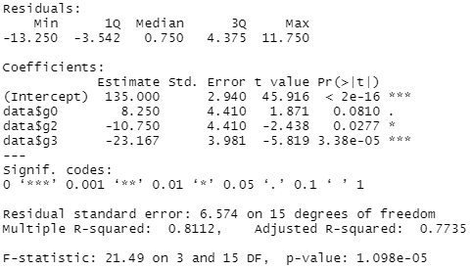
R Functions for One-way ANOVA Using lm()
Create dummy variables and One-way ANOVA using lm() function

Slide 26
First, run a one-way ANOVA (without adjustment for age).
The global F-test showed that mean SBP differed by smoking
category (F=21.49 on 3 and 15 degrees of freedom, p < 0.001).
Notes:
We use aov() when we would like to fit an ANOVA model and view the results in an ANOVA summary table
We use anova() when we would like to compare the fit of nested regression models to determine if a regression model with a certain set of coefficients offers a significantly better fit than a model with only a subset of the coefficients.

Slide 27

After adjusting for multiple comparisons using Tukey’s methodology, all pairwise comparisons except for (a) between light and heavy current smokers and (b) between light and former smokers were significant at the $α$=0.05 level.

Slide 28
However, after adjusting for age using an ANCOVA model, the differences seen in the one-way ANOVA setting, were attenuated and the F-test for the effect of smoking status was no longer significant (F=1.774 on 3 and 14 degrees of freedom, p= 0.1982).
The least-square means (adjusted for age) were 129.87, 144.01, 144.01, and 155.11 for the heavy, light, former and never smokers, respectively.
As such, the differences we saw in the one-way ANOVA model were due to age differences across the smoking groups as opposed to true differences in SBP attributable only to smoking status.

Slide 29
One-way ANCOVA
Notes:
Obtain estimated marginal means (EMMs) for many linear, generalized linear, and mixed models.

Slide 30
One-way ANCOVA
lsmeans: Least-Squares Means
Obtain least-squares means for many linear, generalized linear, and mixed models. Compute contrasts or linear functions of least-squares means and comparisons of slopes. Plots and compact letter displays.
https://cran.r-project.org/web/packages/lsmeans/vignettes/using-lsmeans.pdf

Slide 31
Two-way Analysis of Covariance

Slide 32
Two-way Analysis of Variance
Sometimes, we are interested in comparing the mean response across groups when there is more than one factor to be considered.
When there are two factors (each with two or more levels) that we are interested in, we use the two-way ANOVA methodology instead of the one-way ANOVA methodology.
The goal of a two-way ANOVA aims to look at each factor’s effects after controlling for the effects of the other factor.

Slide 33
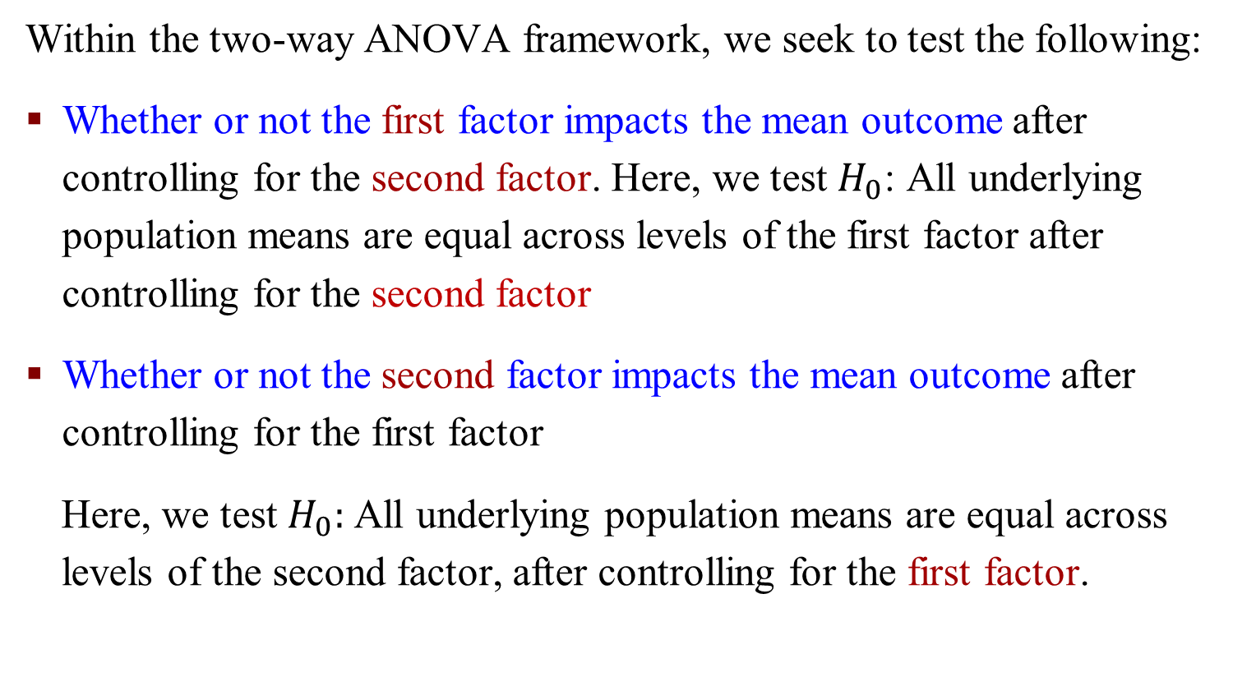
Two-way Analysis of Variance
Within the two-way ANOVA framework, we seek to test the following:
Whether or not the first factor impacts the mean outcome after controlling for the second factor. Here, we test $H_{0}$: All underlying population means are equal across levels of the first factor after controlling for the second factor
Whether or not the second factor impacts the mean outcome after controlling for the first factor
Here, we test $H_{0}:$All underlying population means are equal across levels of the second factor, after controlling for the first factor.

Slide 34
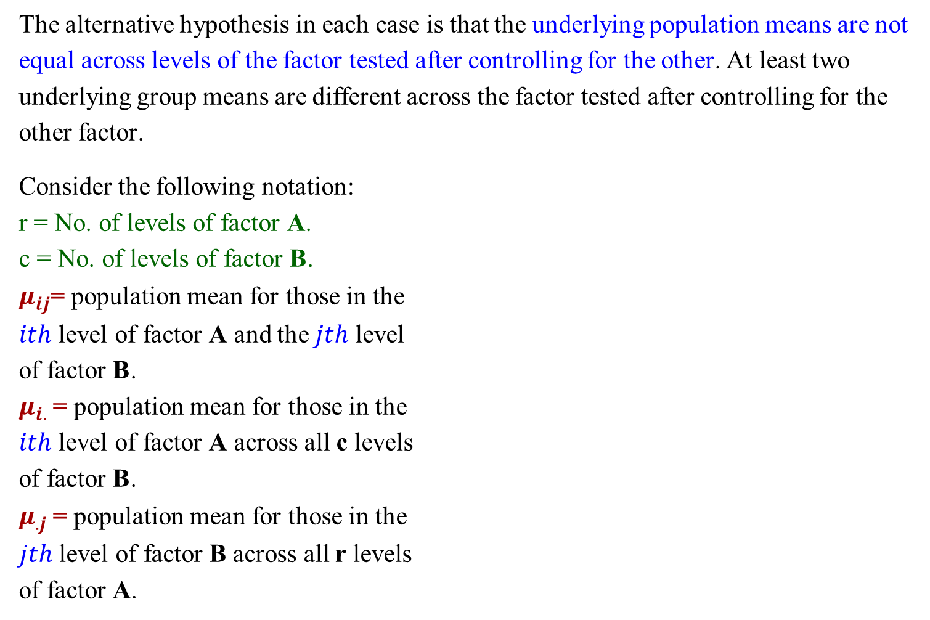
Two-way Analysis of Variance
The alternative hypothesis in each case is that the underlying population means are not equal across levels of the factor tested after controlling for the other. At least two underlying group means are different across the factor tested after controlling for the other factor.
Consider the following notation:
r = No. of levels of factor A.
c = No. of levels of factor B.
$μ_{ij}$= population mean for those in the
$ith$ level of factor A and the $jth$ level
of factor B.
$μ_{i.}$= population mean for those in the
$ith$ level of factor A across all c levels
of factor B.
$μ_{.j}$= population mean for those in the
$jth$ level of factor B across all r levels
of factor A.

Slide 35
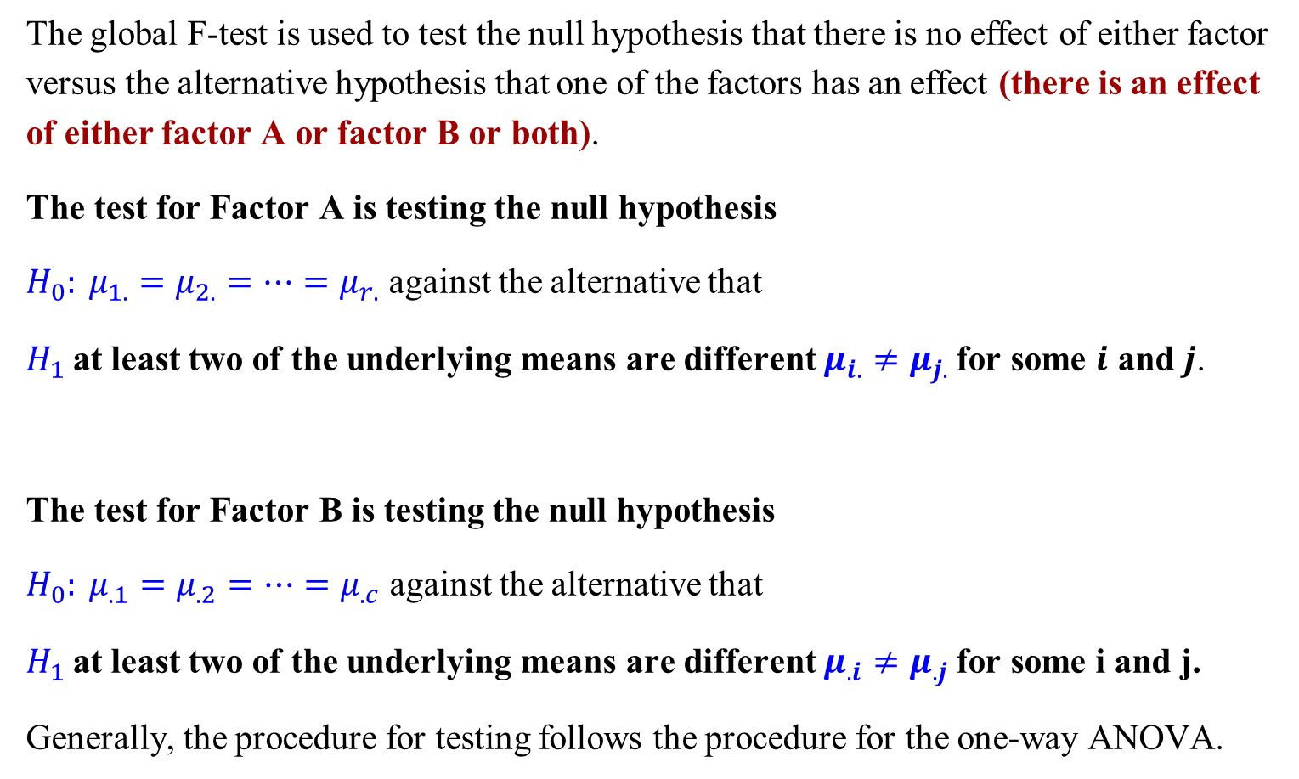
Two-way Analysis of Variance
The global F-test is used to test the null hypothesis that there is no effect of either factor versus the alternative hypothesis that one of the factors has an effect (there is an effect of either factor A or factor B or both).
The test for Factor A is testing the null hypothesis
$H_{0}: μ_{1.}=μ_{2.}=…=μ_{r.}$ against the alternative that
$H_{1}$at least two of the underlying means are different $μ_{i.}≠μ_{j.}$for some $i$ and $j$.
The test for Factor B is testing the null hypothesis
$H_{0}: μ_{.1}=μ_{.2}=…=μ_{.c}$ against the alternative that
$H_{1}$at least two of the underlying means are different $μ_{.i}≠μ_{.j}$for some i and j.
Generally, the procedure for testing follows the procedure for the one-way ANOVA.

Slide 36
Interaction
Besides the global test and the tests for each factor, a test of interaction must be performed to understand if there is a non-additive effect of either of the factors on the response.
One must first conduct an interaction test in the two-way ANOVA setting before the “main effects” type model can be conducted.
The concept of interactions is very important in statistics and in performing any multivariable analysis (including ANCOVA, multivariable regression, and two-way ANOVAs).
Interactions are when the effect of one factor is not constant over the levels of another factor.

Slide 37
Interaction
There is an effect of the drug, but no effect of gender.
The presence and absence of an effect can be observed using the marginal means
Those on drug B have a higher mean SBP (200) versus those on drug A (100)
There does not appear to be an effect of gender (males and females have an average SBP of 150)

Slide 38
Interaction
There is an effect of the drug and an effect of gender.
There also appears to be an effect of gender (males have a higher SBP than females [200 versus 300, respectively]).
Here, the effects of gender are consistent across each drug and the effect of the drug are consistent across levels of gender. We conclude that though males tend to have higher SBPs than women, those on drug A have smaller SBPs than those on drug B. In this case, there is no interaction present.

Slide 39
Interaction
It appears as if there is no effect of drug or gender since all of the marginal means are equal.
On closer examination, it appears there is an effect of these factors, but it varies based on the level of each factor.
Because the effect of the drug depends on gender (and equivalently, the effect of gender depends on the drug used), we say that these factors interact.

Slide 40
Interaction Plots
An educator is interested in the effect of birth month and gender on average reading and math scores for students in the fourth grade. A random sample is taken from each combination.
There is an interaction given that there is not one effect of the birth month across both genders.

Slide 41
Interaction
If there is an interaction between two factors, then the conclusion we’d get from the two-way ANOVA is incorrect and misleading.
Before performing a two-way ANOVA, you must check if an interaction is present.
You do this by including an interaction term in the two-way ANOVA model.
If the p-value of the interaction term is significant, the two-way ANOVA procedure is not appropriate. In this case, one must stratify the analysis by one of the factors and perform separate one-way ANOVAs for the second factor for each level of the first.
If the interaction p-value is not significant, then one can proceed with the typical two-way ANOVA procedure and assume that the effect of each factor is consistent with the other.

Slide 42
Interaction
Given the importance of detecting interactions and the difference in interpretation of results in the presence of an interaction, alpha levels of 0.10 are often used to check if there is an interaction (as opposed to the more common 0.05 level of significance used in most other settings).

Slide 43
Exercise
We are interested in determining the effect of having an MBA and gender on salary. Independent random samples of employees at Company X in a particular department. The means for each of the four categories of employees is shown in the table below. Is there an interaction? If so, what type (quantitative or qualitative)?
 | Mean
Without MBA, Males | 70,000
Without MBA, Females | 65,000
With MBA, Males | 100,000
With MBA, Females | 75,000

Slide 44
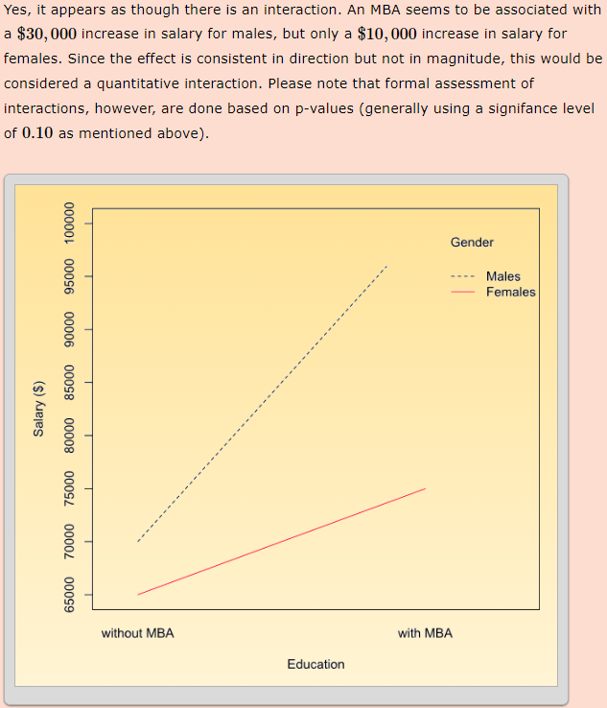

Slide 45
Two-way Analysis of Variance

Slide 46
An Example: Two-way Analysis of Variance
An exercise physiologist wants to examine whether stretching and wearing ankle weights affect the value of exercise on treadmills. To carry out her study, she recruits subjects with roughly the same physical fitness level. She divides them randomly into four groups: with or without ankle weight, with or without a stretching period before the exercise.
Using the number of calories burned as the response, carry out a two-way ANOVA to determine whether stretching and wearing ankle weights significantly affect exercise.
These are the variables in the data set:

Slide 47
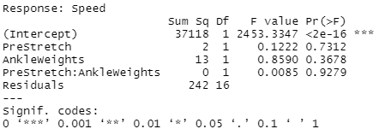
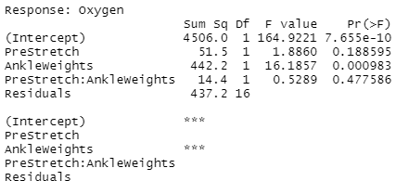
An Example: R Commands
Notes:
Alpha=0.10
Interaction is Presetrect:Ankleweights
Energy: prestretch and ankleweights
Speed: None
Oxygen: Ankleweights

Slide 48
An Example: R Commands
Notes:
col = color

